Slide 1
Description of problem
Audio visual zooming in real time
Isolate targeted sources

Slide 2
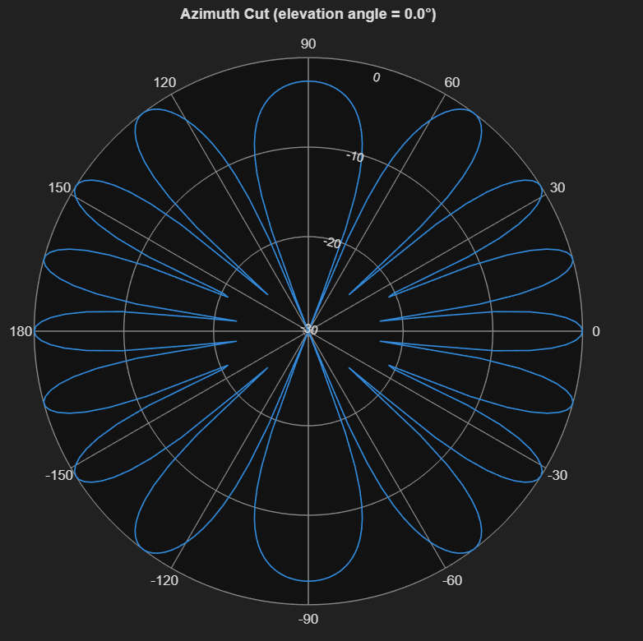
Requirements & setup
2 mics 8cm apart 16khz sampling rate
Target 90deg interference at 40 deg
Source male speech
Interference female speech
Task 3 has speakers setup for
Additive noise from mics
Evaluated by OSINR, STOI, PESQ

Slide 3
Overview of the system

Slide 4
Filtering Process

